Slide 1
MPhys final year research project
PHY00025M
Richard F L Evans
(Project coordinator)

Slide 2
Overview
An advanced research project in an active area of research
You get to experience what it is like to conduct a scientific investigation from inception to completion
The ‘answers’ are not known in advance - you need to discover them!
Consistently noted as the most enjoyable part of the Physics degree by students - you get out what you put in!
Module weighting is 60 credits - half of the credits for the year
Consistent and significant effort is needed throughout the year - 2 days per week is the recommended amount of time, preferably in large blocks of time
The project guide is the definitive source of information about your project - please read it

Slide 3
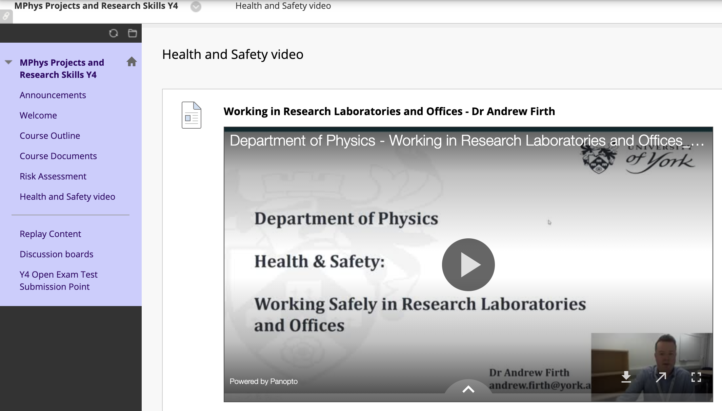
Health and Safety
All projects need to complete a risk assessment
The forms are available on the VLE and needs to be completed including input from your supervisor
Lab risks can include chemicals, radioactive sources, lasers
Remote risks (using computers for long hours) include eye strain, back pain and repetitive strain injuries
Health and safety video on the VLE has additional information

Slide 4
Project supervision
Your supervisor is there to guide you through your research project
Weekly meetings are strongly recommended (bi-weekly is the minimum)
At each meeting you should prepare a brief presentation of your activities from the week
New results
Relevant information from papers you have read
Progress on apparatus building or coding/analysis
Technical and research questions
There may also be group support from PhD students and Post Docs - they are a valuable resource and experienced, and typically have more time than your supervisor to help you

Slide 5
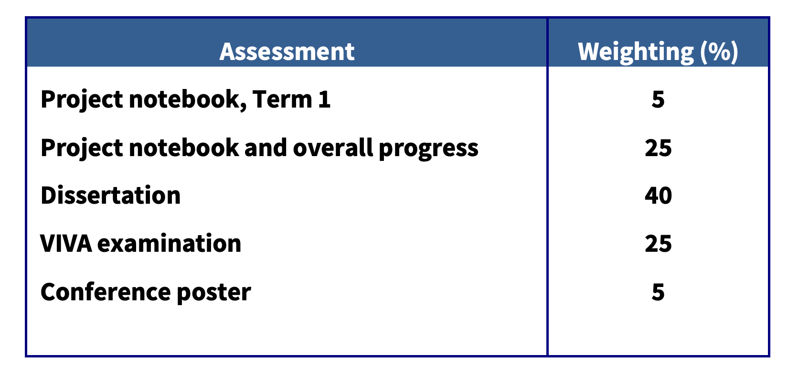
Assessments
Details of the assessments, their content and timeline is detailed in the project guide

Slide 6
Project notebook
Your project notebook should form a contemporaneous record of your project.
All information from your project - notes, ideas, plans, results, analysis, code should be included (you can add photos of relevant apparatus, sketches)
Along with project progress makes up 30% of the mark
This year all project notebooks are online using one of the following
Google Doc (recommended)
Overleaf (recommended for those wanting to learn LaTeX)
elog
You are responsible for setting up your lab book in the platform agreed with your supervisor
Make sure you share your lab book with your supervisor so that they may provide feedback on your progress

Slide 7
Project notebook
Content
The format should match that of a physical lab book from previous years
Pages should be numbered, and entries should be titled and dated
Results, sketches and notes should be embedded in the document
The final version should be exported as a PDF and submitted on the VLE
A phone camera is your friend when it comes to adding content
Both word and overleaf support typesetting of equations (if they are short), longer derivations are probably faster on paper and then upload a photo

Slide 8
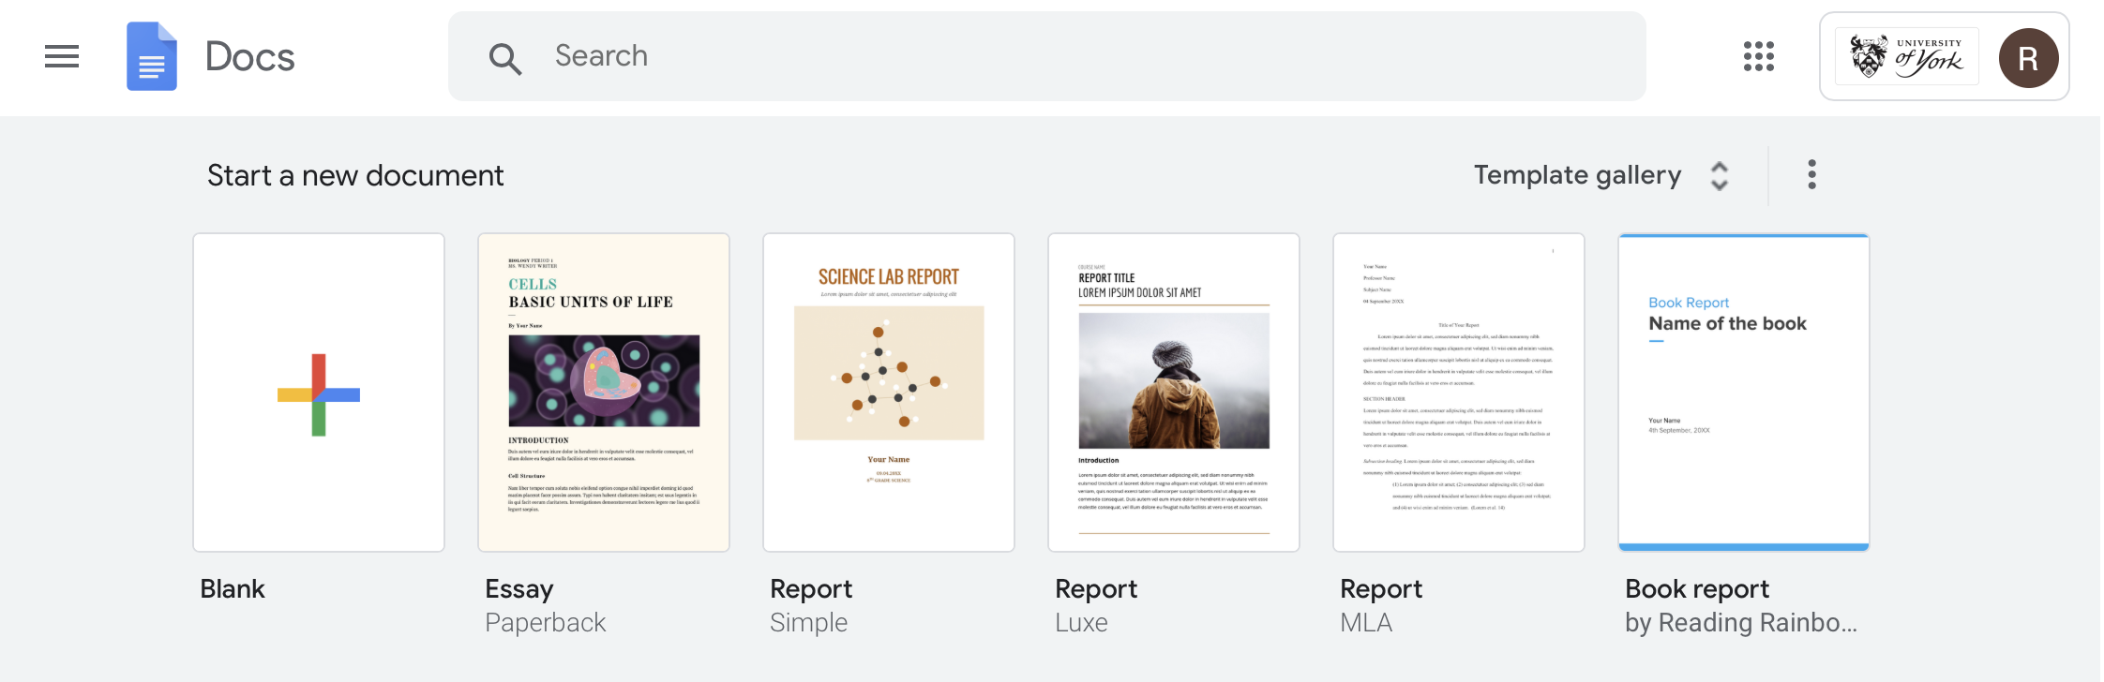
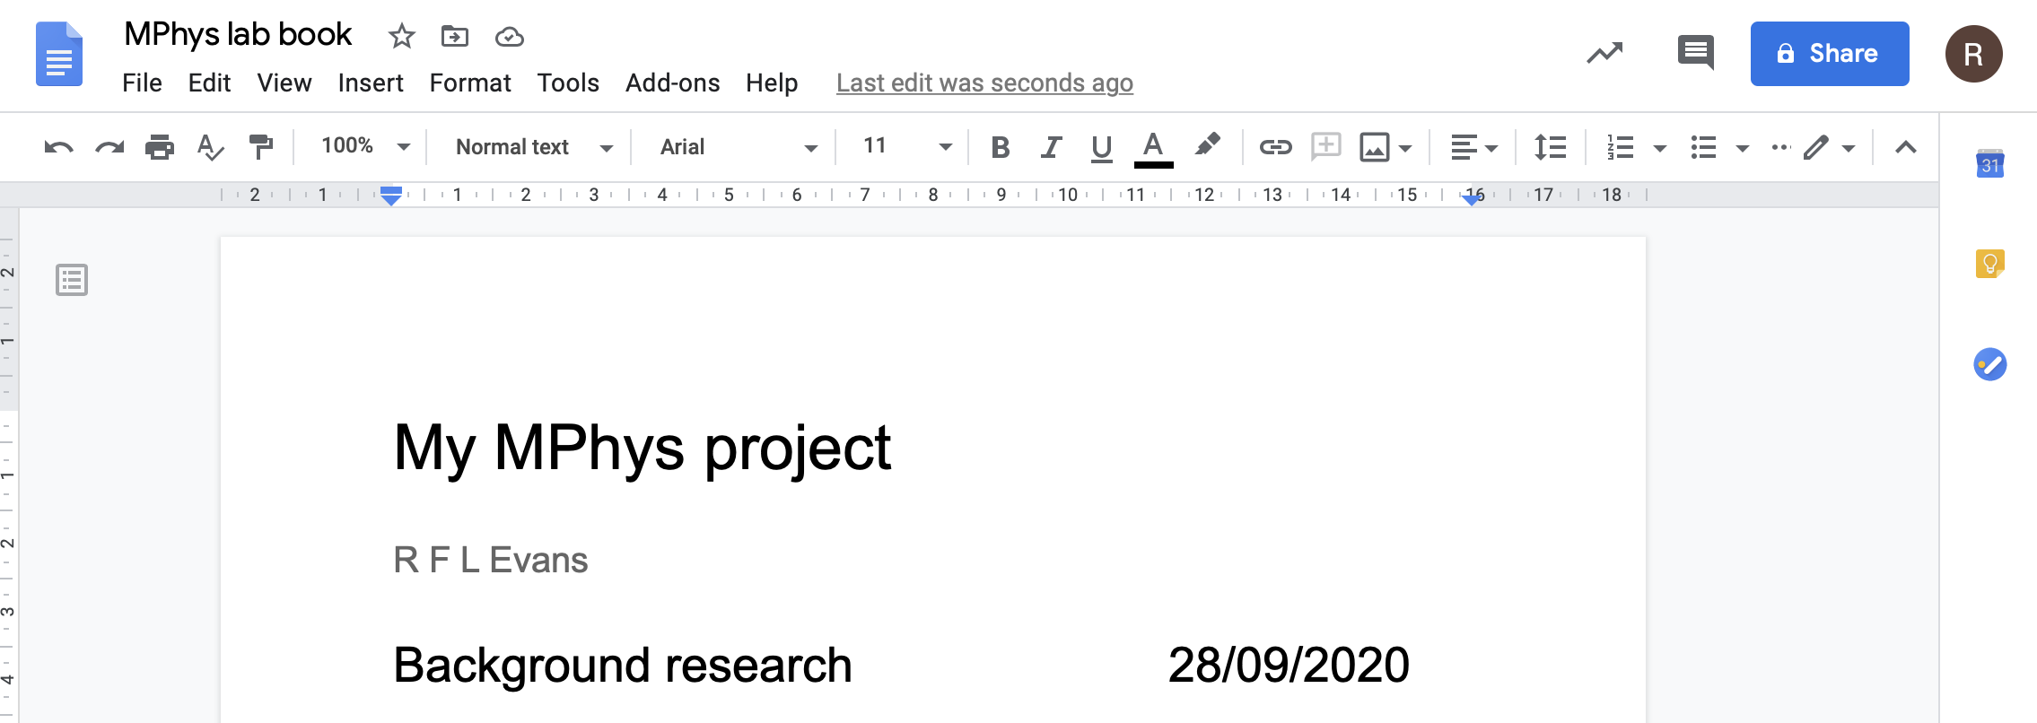
Google Docs: https://docs.google.com

Slide 9
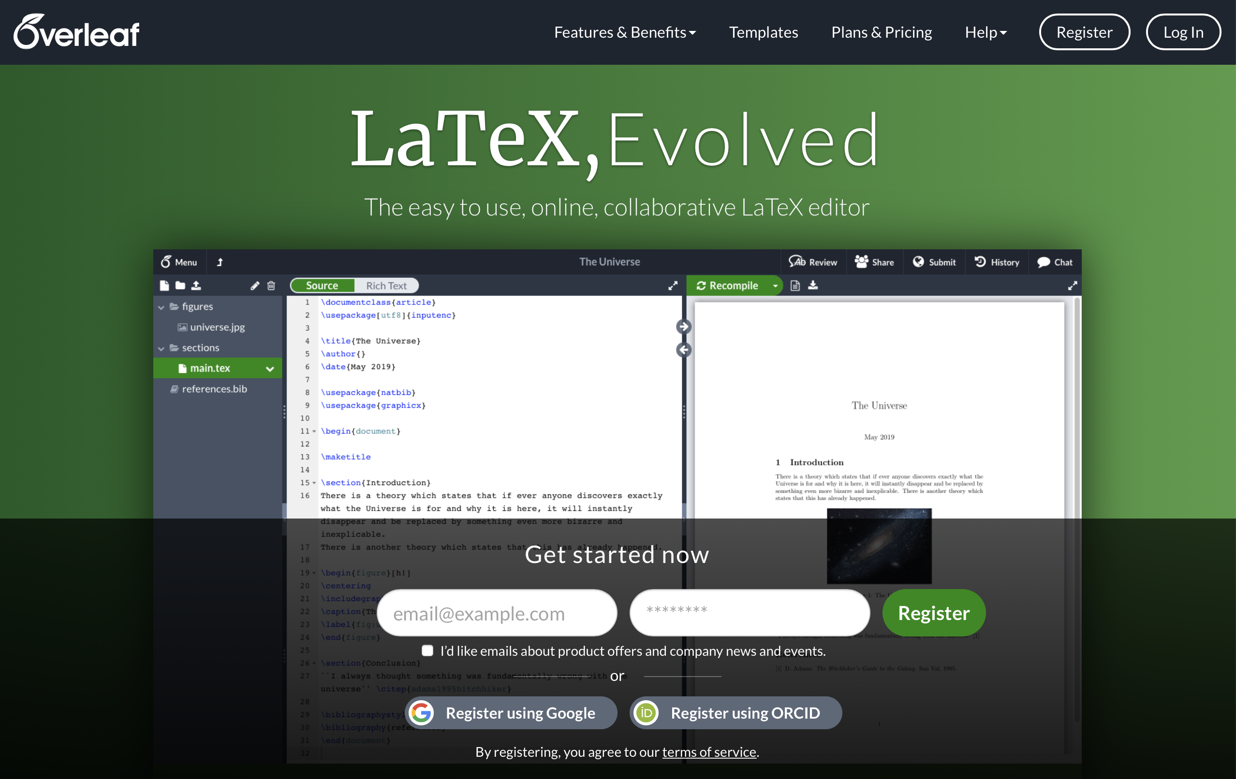
Overleaf: https://www.overleaf.com
University username and password:

Slide 10
Draft literature review
In previous years this was a formally assessed component: now formative but compulsory
Need to produce a draft literature review and methodology by week 10, Autumn term, submission via the VLE
3000 words including background, motivation, theory, methodology and aims
This should form an ongoing piece of work for the whole term as you read and assimilate literature, develop understanding of theory and methodology
LaTeX and Word templates are available on the VLE
You will receive detailed feedback from your supervisor on your review and how it can be improved and where weaknesses exist
As formative work, the revised review (or parts of it) can be included verbatim in the final Project Dissertation

Slide 11
Additional Skills training
Literature search workshop (Clare Ackerley) [Online, week 2]
Unix Skills training for those doing computational projects [10am Friday 9th October BR012A/B] - strongly recommended for those not on TP degree and doing remote projects
Writing workshop for literature review [TBC, Term 1]
Writing workshop for dissertation [Term 2]
How to give poster presentations (Phil Lightfoot) [Term 2]
How to give conference presentations [Term 2]

Slide 12
Summary
Consistent and significant effort is needed throughout the year - 2 days per week is the recommended amount of time, preferably in large blocks of time
The project guide is the definitive source of information about your project - please read it
Health and Safety risk assessment due by Week 1
Setup an electronic lab book and share it with your supervisor
3000 word literature review due by Week 10, Autumn Term

Slide 13
Don’t forget to enjoy the experience!

